Slide 1
AR 4.0
Coming January 2017

Slide 2
What is Ar 4.0?
The New AR with “Tabs”
AR Entry – 2&3
AR Financials – 4
Attachments - 5
Enhancements to Search - 6
Improved Discussion Section - 7
Enhanced Print Capabilities - 8
Easier Approval - 9
More stability and future sustainability

Slide 3
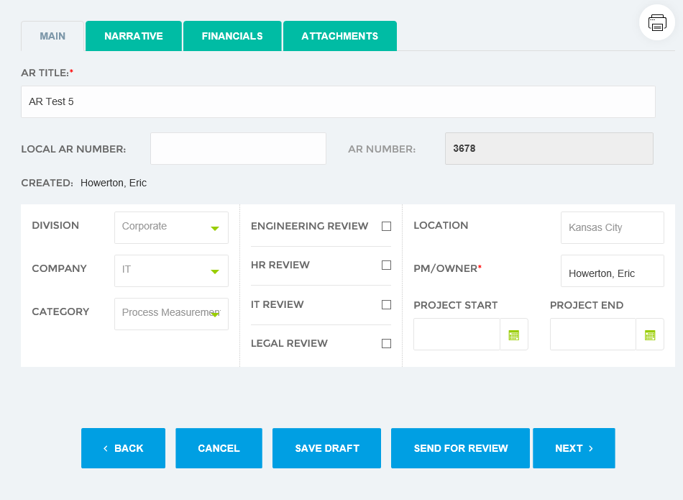
Main Tab
AR Title
Division
Company
Category (new)

Slide 4
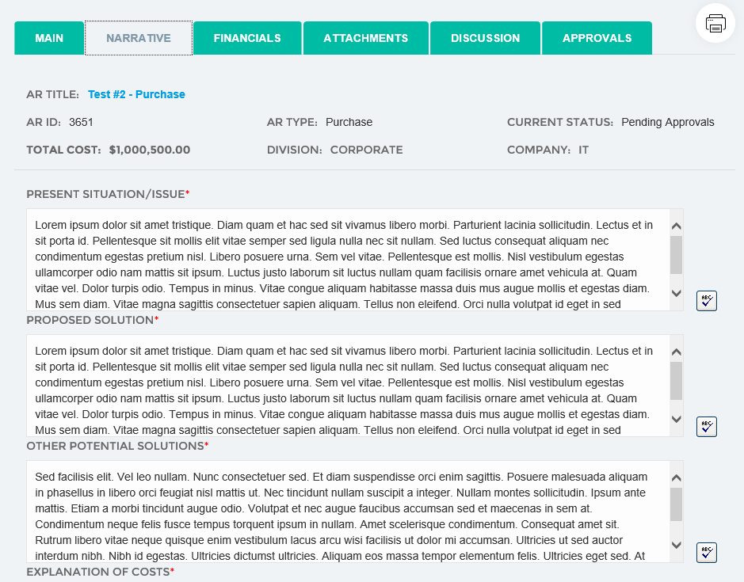
Narrative Tab
Present Situation
Proposed Solution
Other Solutions

Slide 5
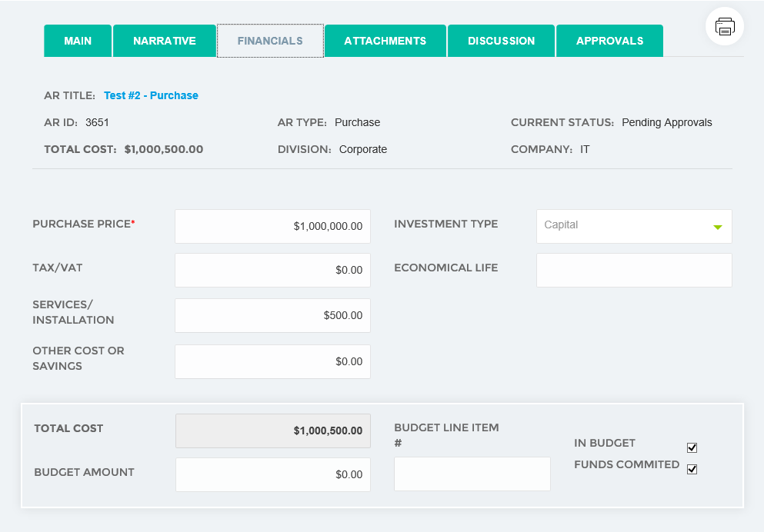
Financials Tab
All key financial data
By AR Type

Slide 6
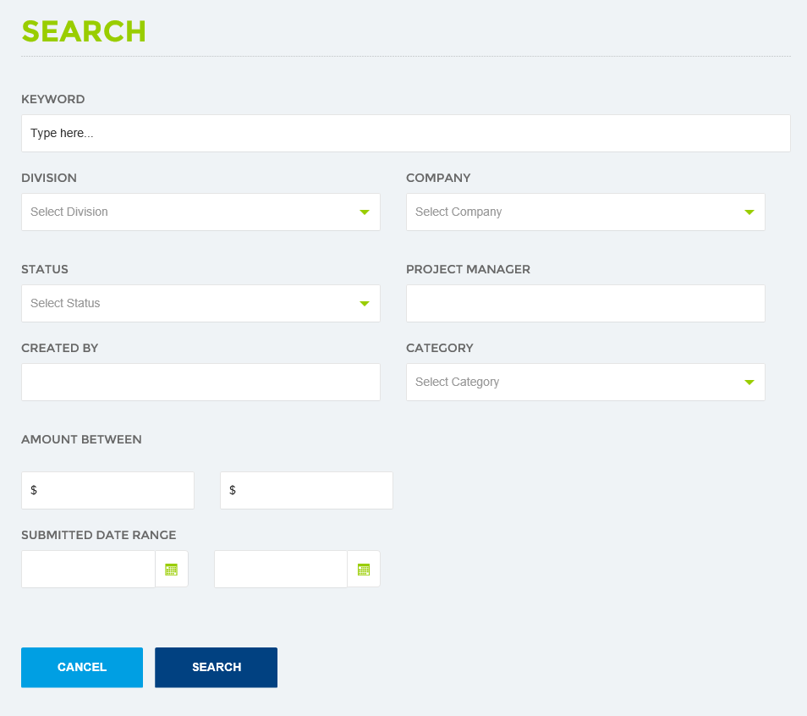
Search
Search for ARs
Easily filter results
AR cost ranges
Date ranges

Slide 7
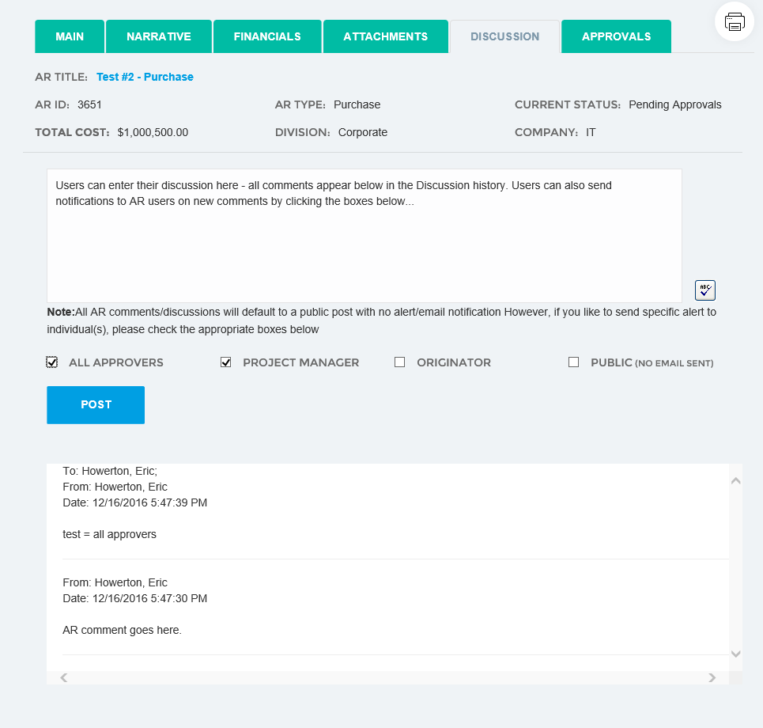
Discussion Tab
New comments
Ability to notify users on new comments
Comment history

Slide 8
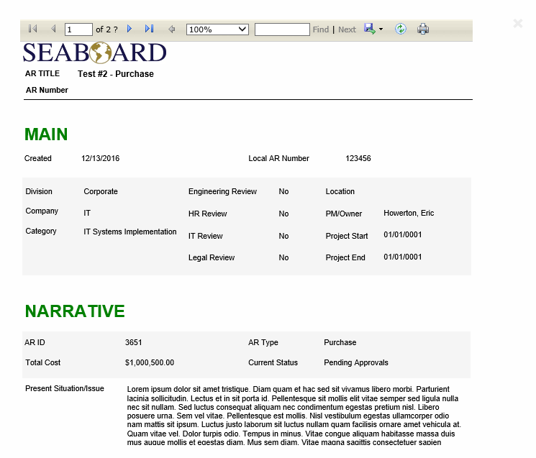
Print
New print interface
Complies AR data into easy to print template

Slide 9
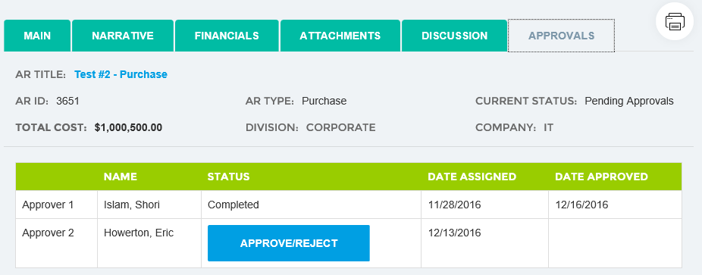
Approvals Tab
New approve button
Simple interface

